Slide 1
International
Financial Aid
How will we pay for this?

Slide 2
$100 billion credit over
10 years
How will we pay for this?

Slide 3
~2% concessionary development rate loans
How will we pay for this?

Slide 4
*including potential grace period of
5 years
How will we pay for this?

Slide 5
Gulf Cooperation Council
Countries holding
$4 Trillion
How will we pay for this?

Slide 6
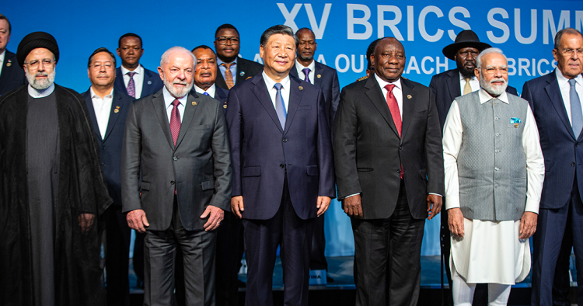
BRICS+
How will we pay for this?

Slide 7

Islamic
Development
Banks
How will we pay for this?

Slide 8
Saudi Arabia
How will we pay for this?

Slide 9
Sovereign Wealth
Funds
How will we pay for this?

Slide 10
Reconstruction of the
Palestinian areas +
What is involved?

Slide 11
+ the full building of the
Oasis Plan infrastructure
What is involved?

Slide 12

How will we pay for this?

Slide 13

How will we pay for this?

Slide 14
How will we pay for this?

Slide 15
Development
Banks
How will we pay for this?

Slide 16
20 years
Duration
How will we pay for this?

Slide 17
concessionary development Loans
How will we pay for this?

Slide 18
rate of
~ 2%
How will we pay for this?
Notes:
Test

Slide 19
debt service payments by Israel
How will we pay for this?

Slide 20
U.S. and other nations as
Guarantors
How will we pay for this?

Slide 21
Military Logistics Unit within UN Peacekeeping Missions
How will we pay for this?

Slide 22
The United Nations
Relief and Works Agency for Palestine Refugees in the Near East (UNRWA)
How will we pay for this?

Slide 23
International
Peace
Conference
How will we pay for this?

